Slide 1
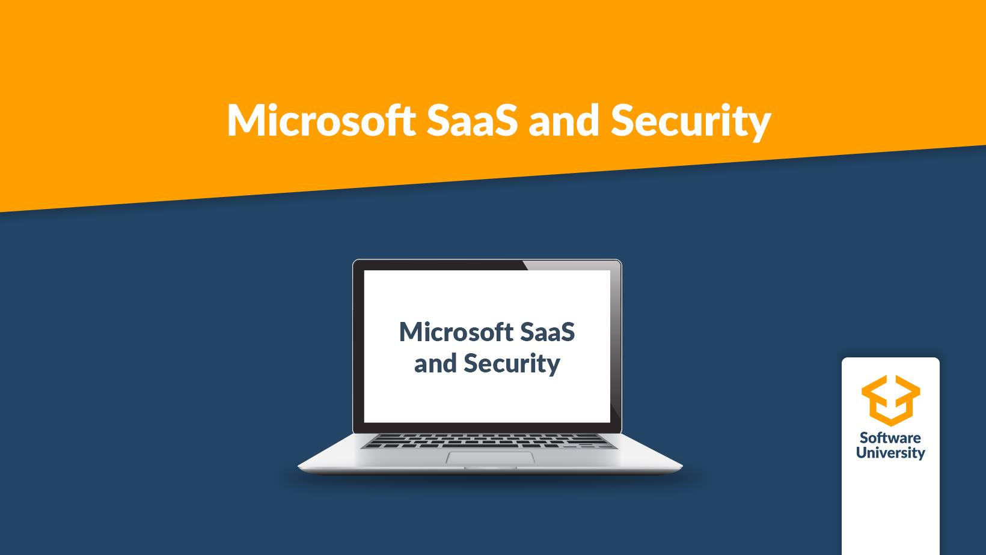
Course summary
Module 6
SoftUni Team
Technical Trainers
Software University
http://softuni.bg

Slide 2
Questions
sli.do # SaaS-Security

Slide 3
Table of Contents
Cloud services concepts. Introducing Microsoft 365
Identity management
Collaboration services in Microsoft 365
Security considerations in Exchange and SharePoint Online. Mobile Device Management
Microsoft 365 Information Protection

Slide 4
Cloud services concepts. Introducing Microsoft 365

Slide 5
Introduction to Cloud computing

Slide 6
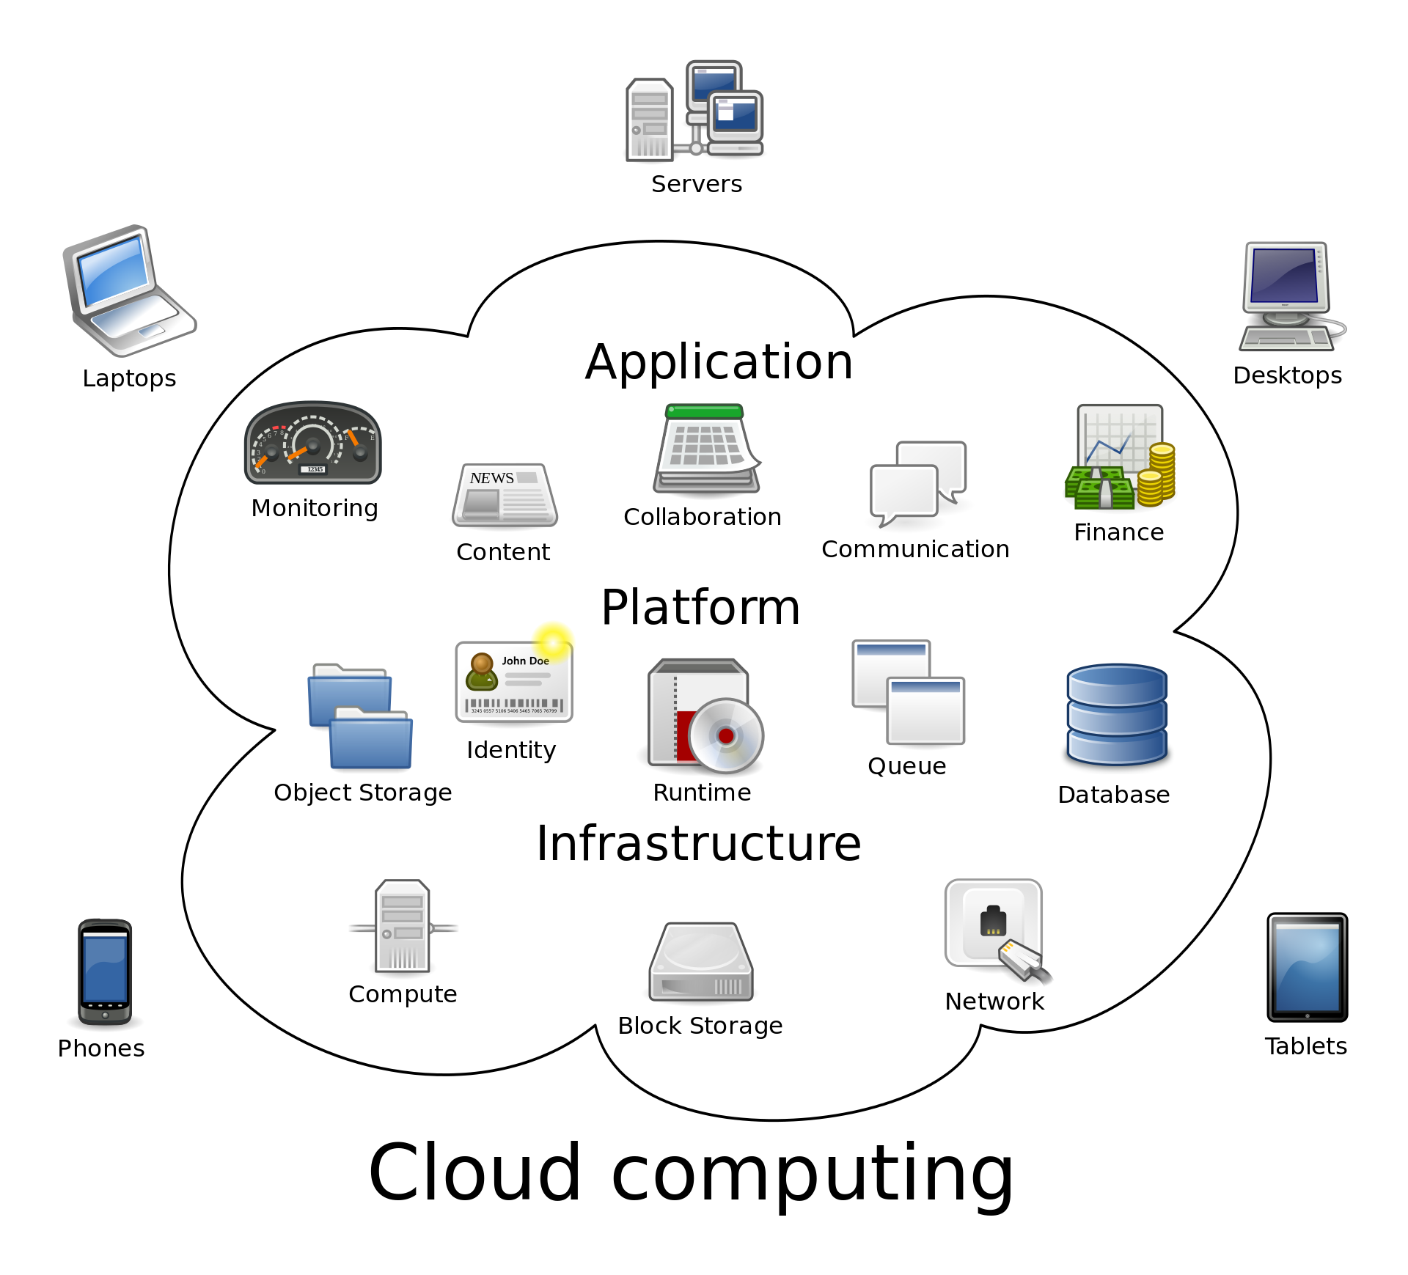
What is Cloud computing?
Computing services are delivered over the Internet, a.k.a “the cloud”
Computing services can be:
Servers
Storage
Networking
Databases
Software

Slide 7
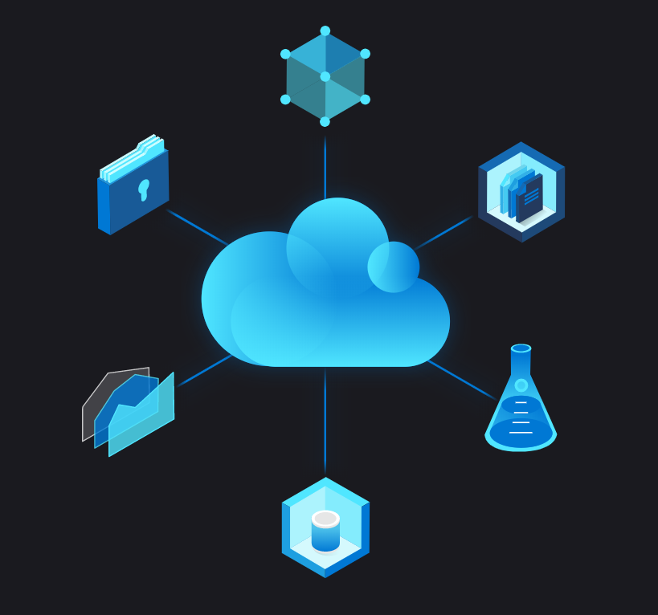

The benefits
Flexible
Fast for deployment
Scalable
Meets new regulations
Secure
Cost-effective
Really?

Slide 8
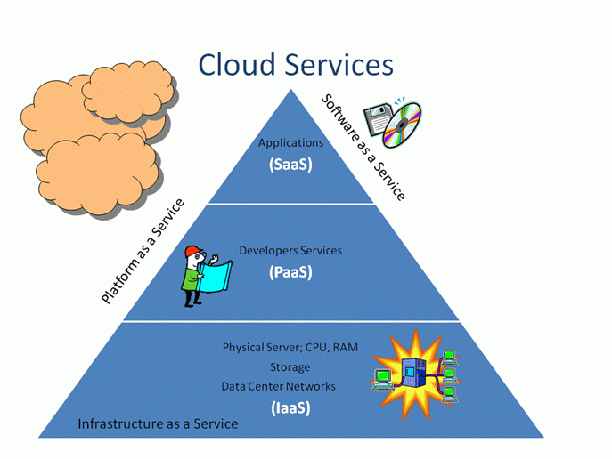
Types of Cloud services

Slide 9
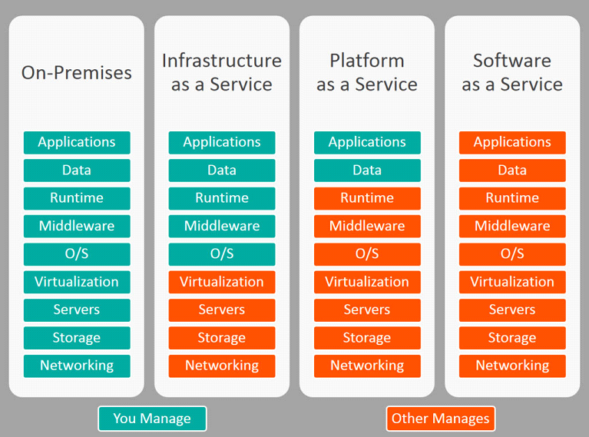
Types of Cloud services (2)

Slide 10

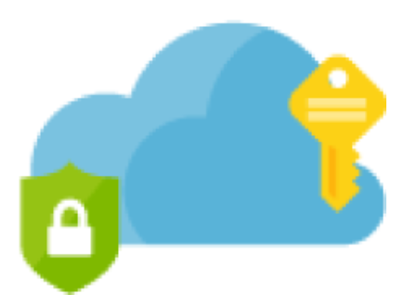

Public vs private vs hybrid cloud
Public cloud:
Operated by third-party cloud service provider
Each customer has its own isolated “tenant”
Security?
Private cloud:
The hardware and the software are dedicated to your organization
Can be hosted locally or at a service provider
More flexible
Hybrid cloud:
The best of both worlds
Data and apps can be moved between public and private clouds for greater flexibility

Slide 11

Challenges
Security
Compliance
Cost
Reliability
Lack of expertise
Vendor lock-in
Notes:
Compliance note: J.P. Morgan created its own private cloud in 2016 and moved some applications into the public cloud in May 2017 - https://blogs.wsj.com/cio/2017/03/30/j-p-morgan-set-to-run-first-apps-in-public-cloud/
Reliability note: For example, less than 99.9% availability of Exchange Online, results in “service credit” of 25%. Less than 99% -> 50% of service credit and less than 95% -> 100% of service credit

Slide 12
Plan and design your IT infrastructure

Slide 13
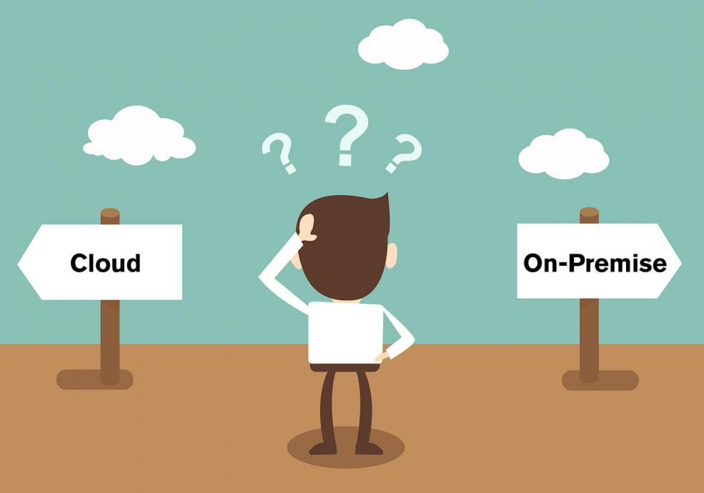
“On-premises” vs “In the cloud”
You receive the service you need (almost) immediately
You can plan your expenses
You rely on the public Internet
More services today are released using the “cloud-first” approach
The only option for companies in the past (if it ain’t broke, don’t fix it)
Better control
More customization options
Reliable and secure

Slide 14

On-premises + Cloud = Hybrid
Often there are existing directory services on-premises
Do I need separate accounts for the on-premises services and for these in the Cloud?
Hybrid identity: the way to use the “same account” on-premises and in the cloud

Slide 15
Core Microsoft 365 services

Slide 16

Office 365 metaphor
Outlook, Delve
Excel, Yammer
Stream, Planner
Flow, Teams
Forms, OneNote
PowerPoint, SharePoint
StaffHub, Stream
Sway, OneDrive
Etc…
Office 365

Slide 17
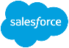











Enterprise Mobility and Security (EMS)
Extend enterprise-grade security to your cloud and SaaS apps
Microsoft Cloud App Security
Microsoft
Intune
Azure Active Directory Premium
Azure Information Protection
Protect your data, everywhere
Protect your users, devices, and apps
Detect threats early with visibility and threat analytics
Microsoft
Advanced Threat Analytics

Slide 18

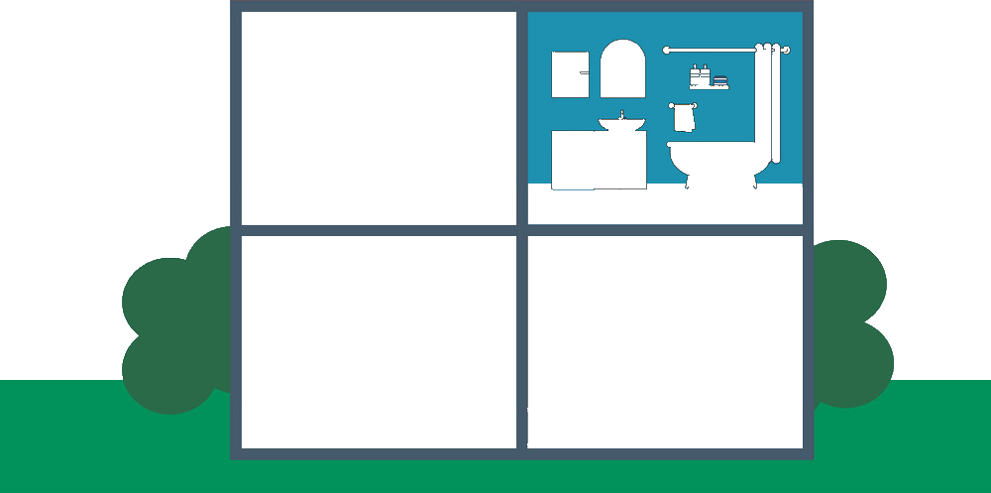
So what is Microsoft 365?
This is Microsoft 365!
EMS – Enterprise Mobility and Security
E
M
S
Outlook, Delve
Excel, Yammer
Stream, Planner
Flow, Teams
Forms, OneNote
PowerPoint, SharePoint
StaffHub, Stream
Sway, OneDrive
Etc…
Office 365
Windows 10

Slide 19
Create and setup a new tenant

Slide 20

What is a “tenant”?
Tenant is the company’s space/resources in the cloud.
The tenants are isolated from each-other
Company “C” cloud instance
Company “A” cloud instance
C
A
B
D
Company “B” cloud instance
Company “D” cloud instance

Slide 21
Tenant vs subscription
Tenant is the company’s cloud instance
Subscription is agreement (with Microsoft) to use one or more cloud services
Microsoft’s SaaS offerings charge per user, per month
In this course, we will create tenants and will use free/trial subscriptions for them

Slide 22
Office 365 vs Azure
Every Office 365 client is also an Azure client!
Office 365 and Azure services rely on Azure Active Directory (Azure AD) to work with the identities (accounts)
Office/Microsoft 365
Azure
Azure

Slide 23
Questions
sli.do # SaaS-Security

Slide 24
Identity management

Slide 25
General principles

Slide 26
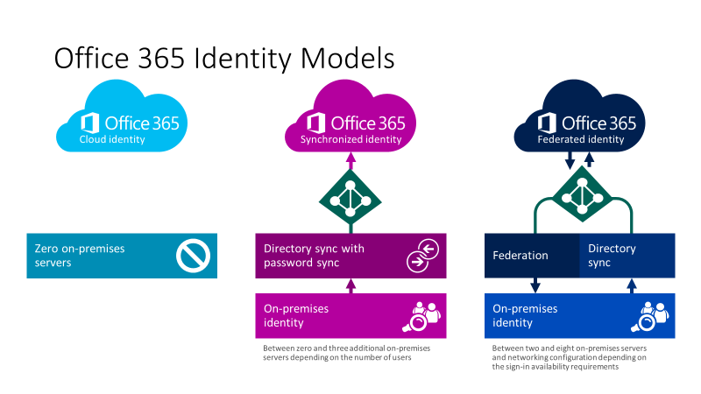
User account types
Cloud identities
Synchronized identities
Federated identities
Notes:
https://www.microsoft.com/en-us/microsoft-365/blog/2014/05/13/choosing-a-sign-in-model-for-office-365/

Slide 27
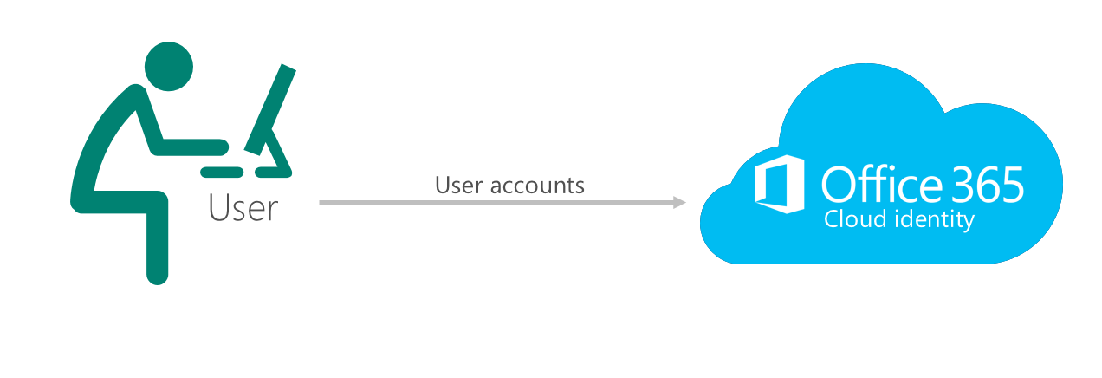
Cloud-only identities
Users are created and managed in Office 365 (Azure AD)
The passwords are verified by Azure AD

Slide 28
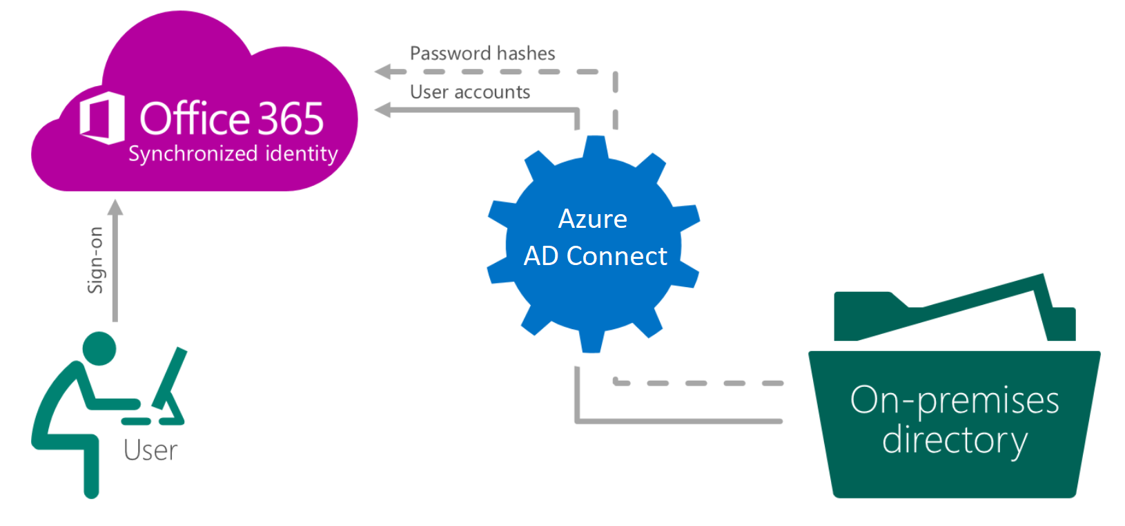
Synchronized identities
Users are created and managed on-premises, then synced to Azure AD (with the passwords hashes)
The passwords are verified by Azure AD

Slide 29
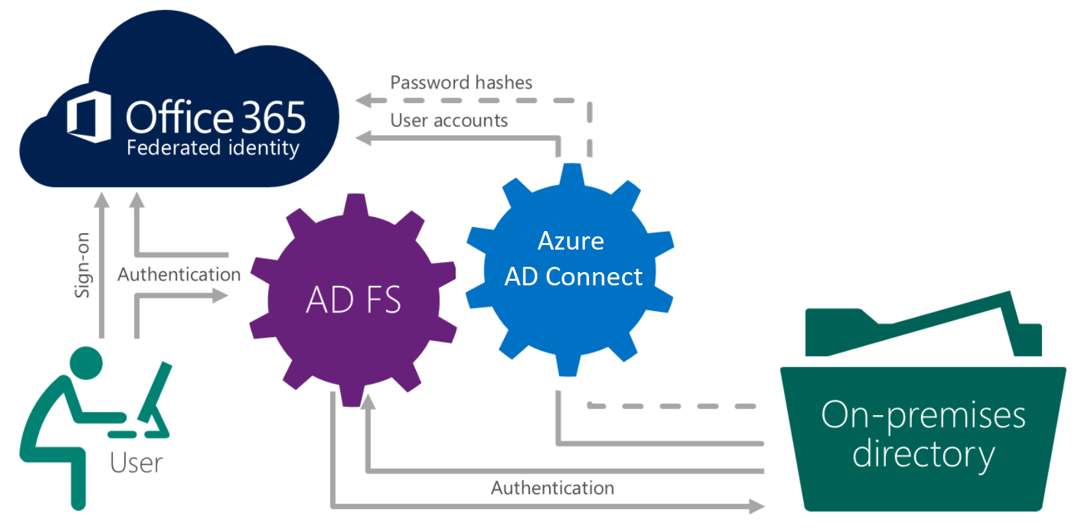
Federated identities
Users are created and managed on-premises, then synced to Azure AD (no need to sync password hashes)
The passwords are verified on-premises
Notes:
https://www.youtube.com/watch?v=ireTh8eFTkM

Slide 30

Authentication options
Cloud-only authentication
Synchronized identity authentication
Federated identity authentication
Azure AD
Azure AD
Azure AD
Azure AD Connect and password sync
Azure AD
Connect
Federation
AD DS
AD DS
Independent cloud identity
Single identity, enabling a same sign-on experience with password hash synchronization
Single federated identity, enabling SSO in some scenarios and additional flexibility

Slide 31
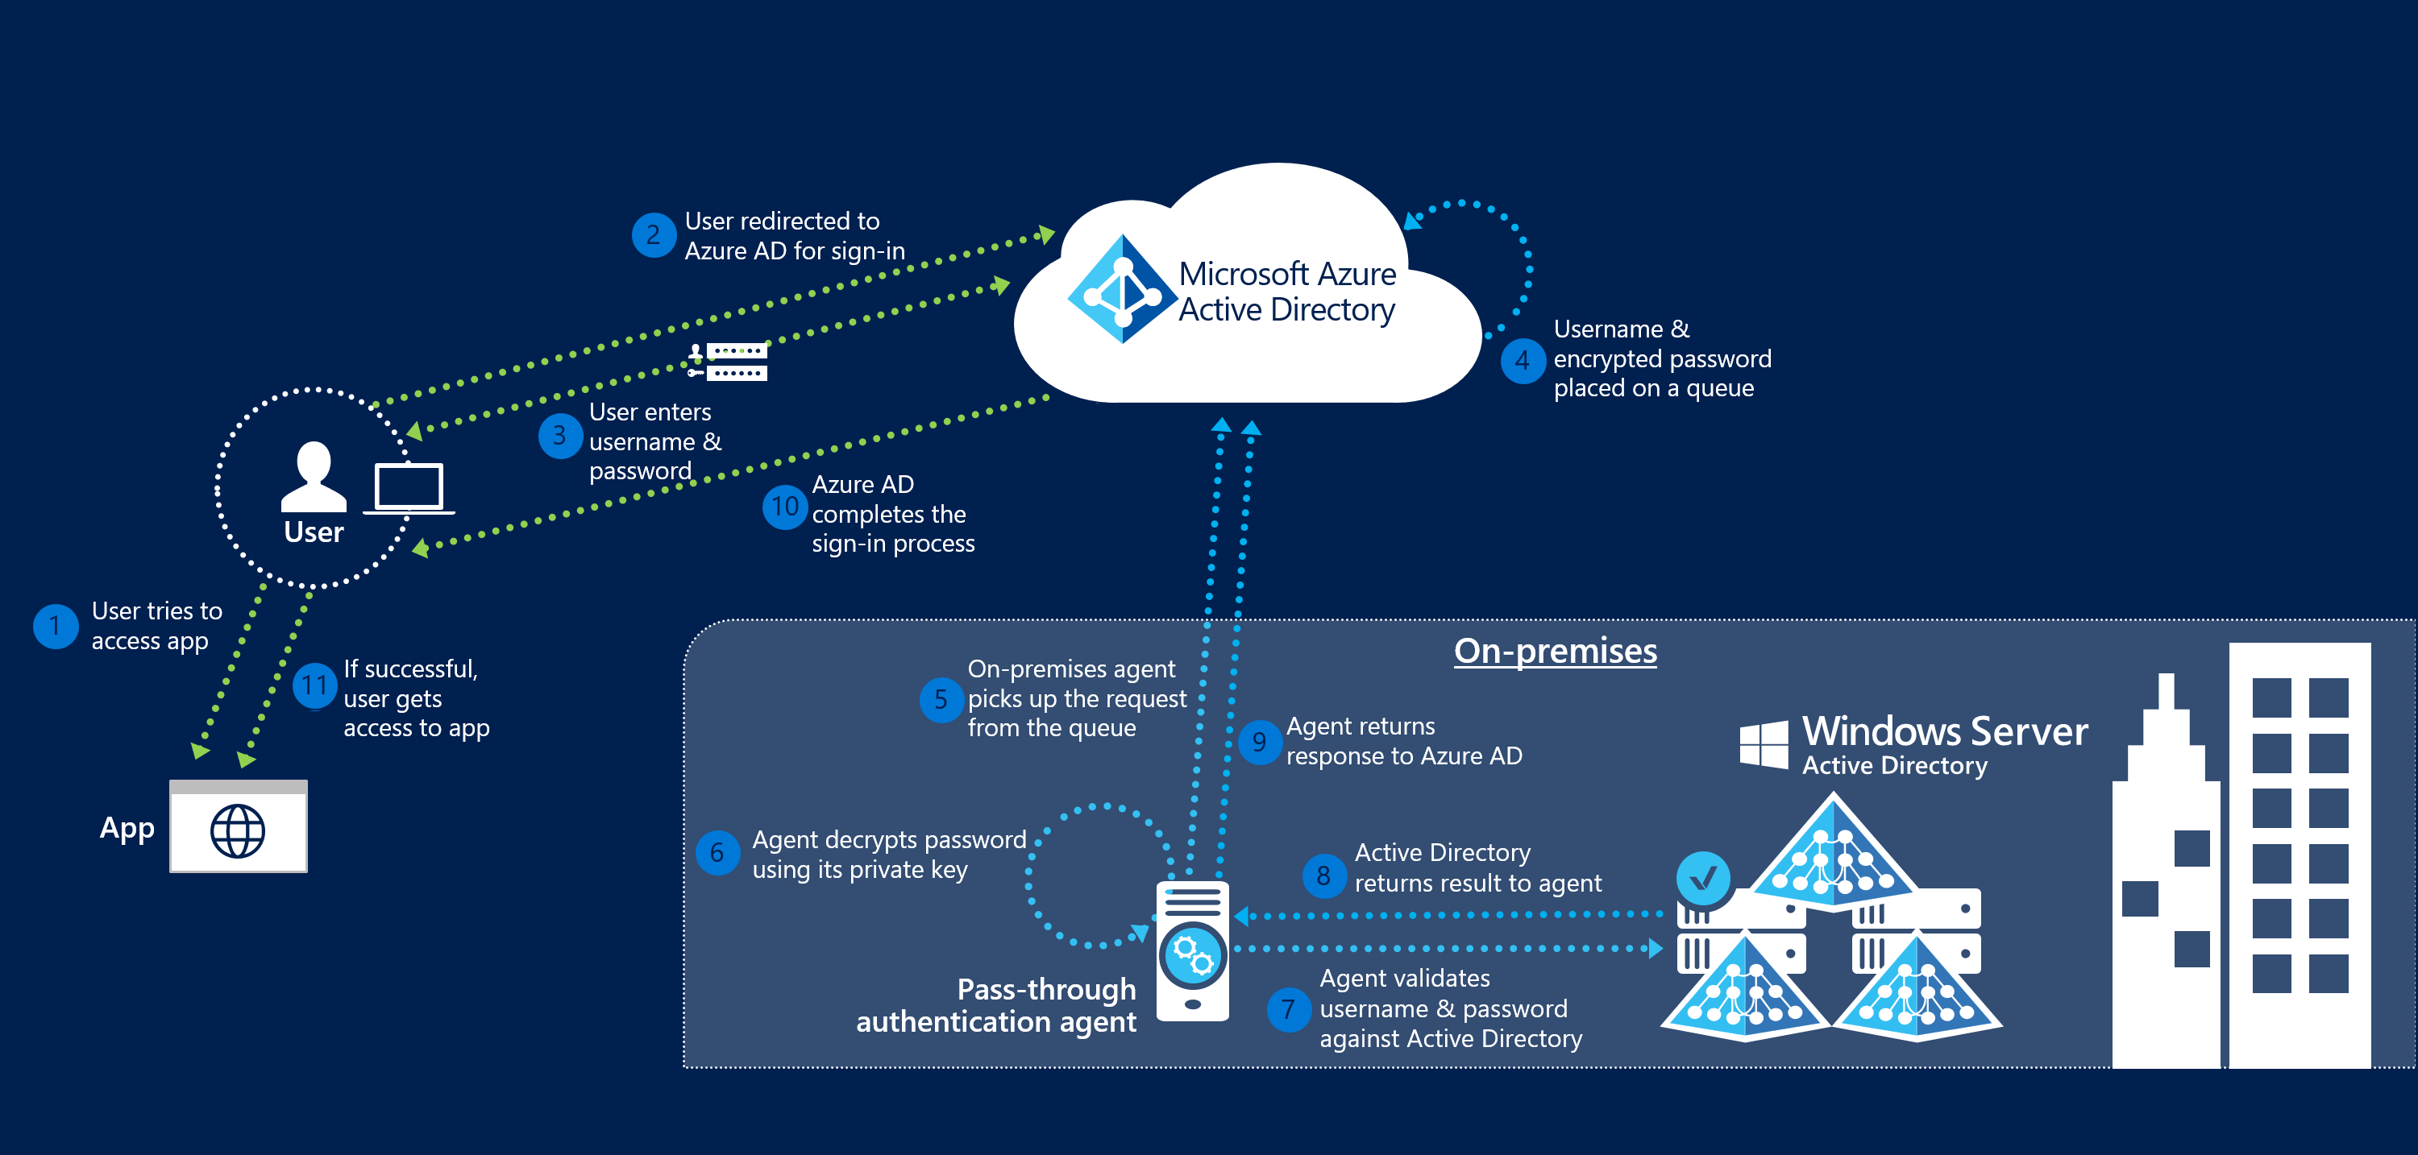
Azure AD pass-through authentication (PTA)

Slide 32
User Principal Name (UPN)
The [unique] logon name of the user
Example: Ivan.Petrov@softuni.bg
It should map to the user email address
Default domain for new subscriptions is: tenantname.onmicrosoft.com
…meaning that the default UPN of the users is like this:
Ivan.Petrov@softunibg.onmicrosoft.com

Slide 33
Windows AD vs Azure AD
Azure AD is not “another Windows AD, but in the cloud”
Azure AD is very similar to AD DS (Active Directory Domain Services), but there are differences:
No group policies and no structuring in the form of OUs (Organizational Unites) in Azure AD
Authentication is different - AD DS uses Kerberos, while Azure AD uses protocols over HTTP(S) - SAML, OAuth (for authorization)
AD DS uses LDAP for queries, Azure AD uses REST API over HTTPS

Slide 34
Security considerations and mechanisms to protect

Slide 35
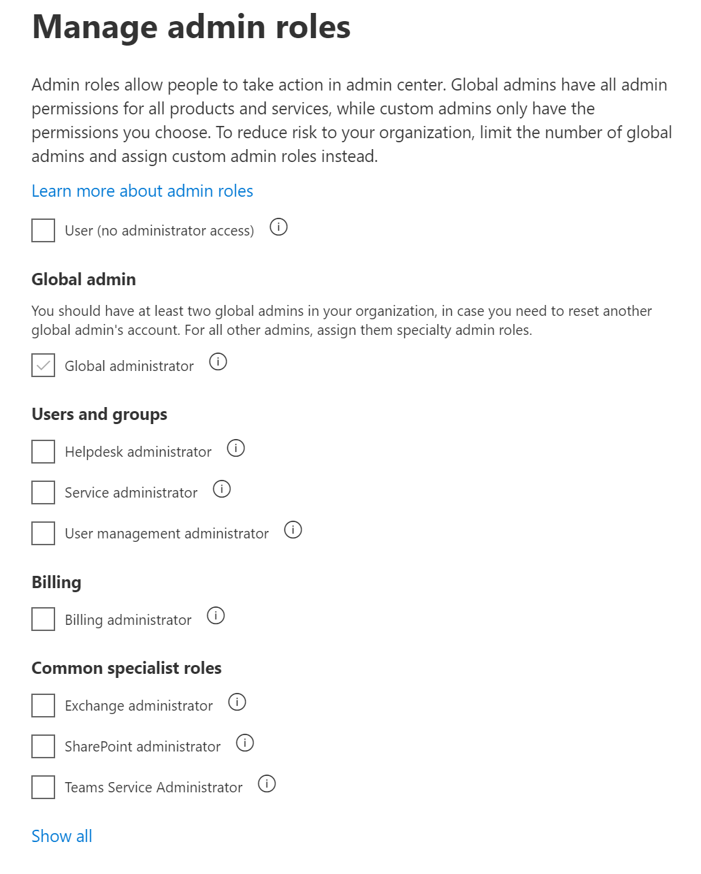
User account roles
Each account in Office 365 can be either with a “user” role or some type of admin:
Global administrator
User management administrator
Service administrator
Exchange administrator
SharePoint administrator
etc.
A user can be with an admin role and without any license

Slide 36
User account protection
User account attacks are widespread, dangerous and hard to detect
Protection
Passwords and password policies
Multi-factor authentication
Conditional access
Secure score

Slide 37
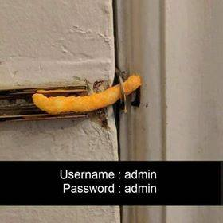
Passwords and password policies
Password policies for synced (from local AD) accounts:
Password complexity policy (the on-premise instance settings applied)
Password expiration policy (the cloud password is set to “never expire”)
Password policies for cloud-only accounts
Password complexity policy (default settings, cannot be modified)
Password expiration policy (configurable in the portal)

Slide 38
Reset passwords for users and admins
Who can reset users’ passwords?
Global administrator or a custom “password” administrator
Users can reset their own passwords (SSPR) - must be enabled (if the user is synced, Azure AD Premium plan is required)
Who can reset administrators’ passwords?
Another Office 365 administrator
Administrators can reset their own passwords (SSPR) - enabled by default (if the user is synced, Azure AD Premium plan is required)

Slide 39
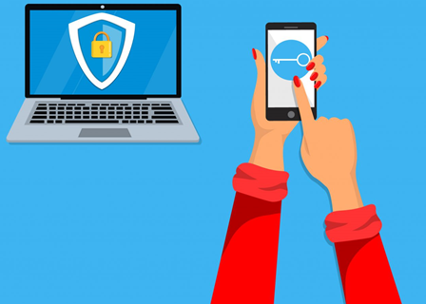
Multi-factor authentication (MFA)
MFA requires more than one verification method
Adds a second layer of security
For cloud-only identities, the second factor can be:
Authentication phone (SMS)
Mobile app (notifications or verification code) - preferred method

Slide 40
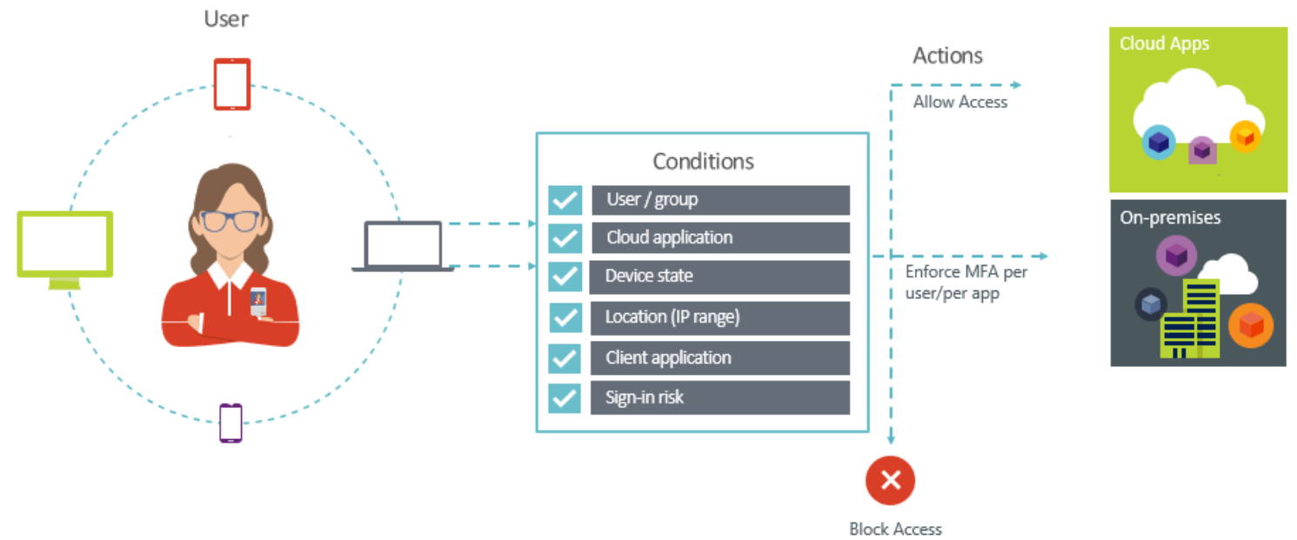
Conditional access
Automated access control decisions
Not just who, but how a resource is accessed matters
It is a feature of Azure AD

Slide 41
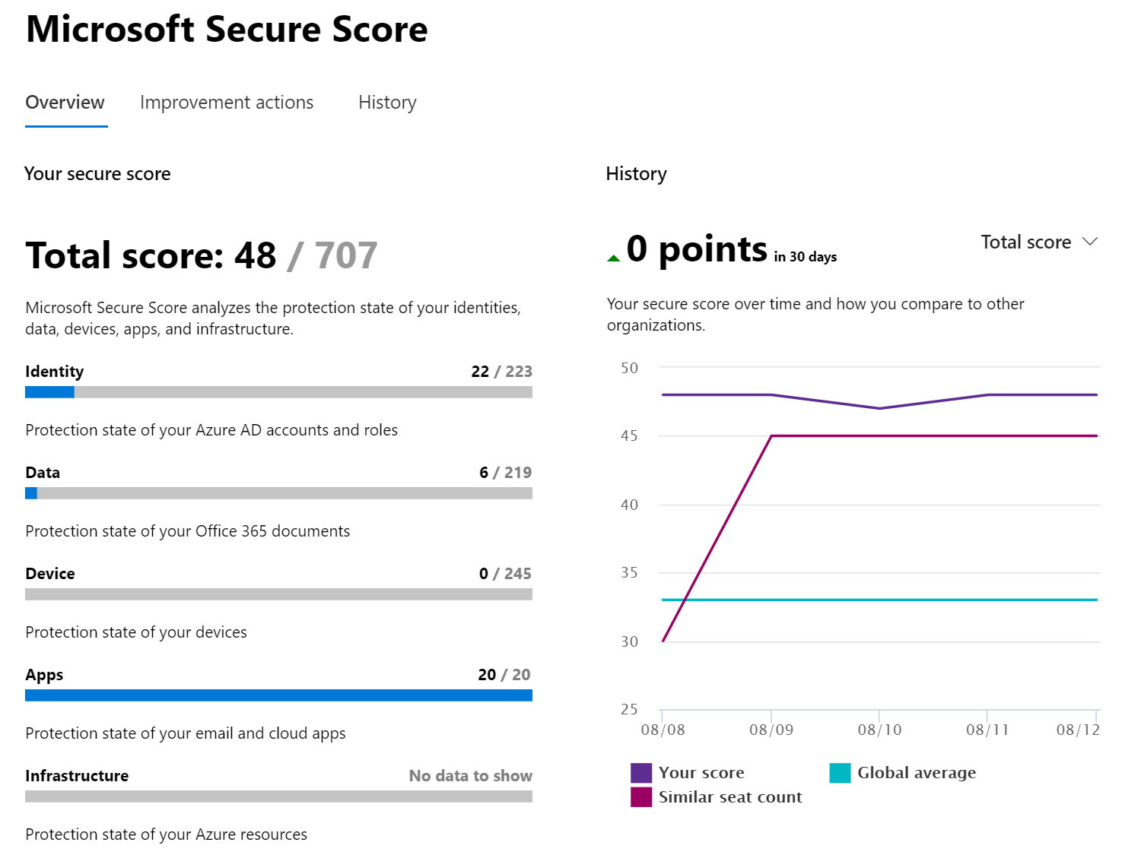
Secure score
Visualizes the security level of your tenant
Compares with other companies with similar seat count
Compares with the “global average”
Gives improvement actions to increase your score

Slide 42
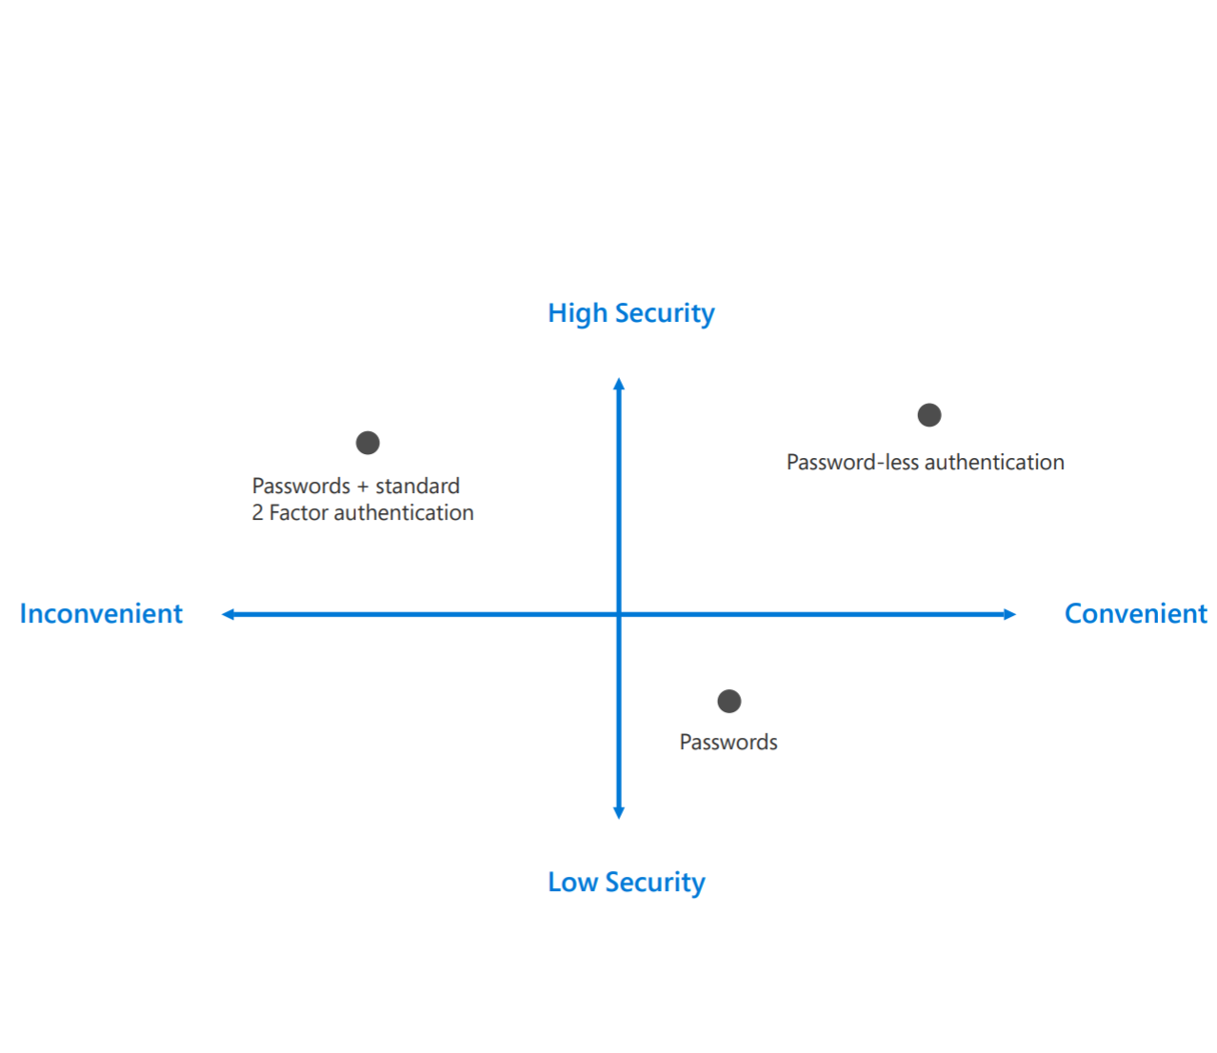
The end of passwords
Passwords are no longer enough
How to go password-less?
Windows HELLO for Business (biometric or PIN)
FIDO2 support for password-less sign-in
Microsoft Authentication app
User adoption – educate your employees
Notes:
https://www.microsoft.com/en-us/security/technology/identity-access-management/passwordless

Slide 43
Creating identities in the cloud

Slide 44
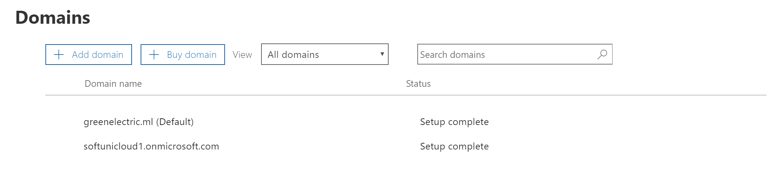
Add a custom domain
Remember the [ugly] something.onmicrosoft.com domain?
In order to have users in the format ivan.petrov@mydomain.com, we need to add mydomain.com in our tenant
To do it, we need to prove the ownership (by adding a DNS record)
Optionally, we can transfer the DNS management inside Office 365
Custom domain
Initial domain

Slide 45
Options to create identities
To create identities in the cloud, several options exist:
From the Microsoft 365 admin center
Using PowerShell
Import from file
Using directory synchronization (Azure AD connect)

Slide 46
Deleting and recovering user accounts
Carefully plan what and how you are going to delete
The user’s content is typically kept (and recoverable) for 30 days after deletion
The user’s license will be available for other users after deletion
You can restore the user’s account (and data) within 30 days if the user is in the recycle bin (deleted users)
You can permanently delete a user account with PowerShell

Slide 47
Questions
sli.do # SaaS-Security

Slide 48
Collaboration services in Microsoft 365

Slide 49
Different ways for teamwork and communication

Slide 50
Work faster and smarter
It is all about improving our efficiency, securely
Today we will focus on:
Exchange Online
Planner
Yammer
SharePoint Online
Forms
Kaizala
Microsoft Teams
Delve
Flow
more…
OneDrive for Business
Stream
Power BI
Office 365 ProPlus
Sway
PowerApps

Slide 51
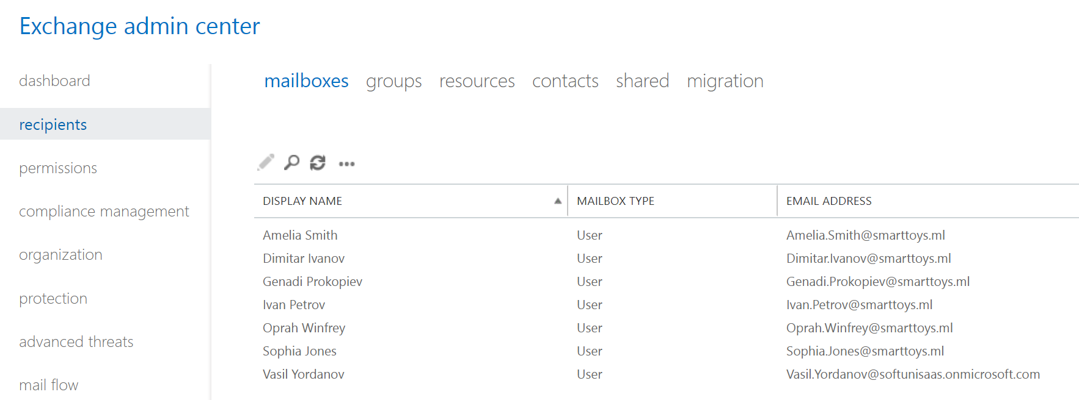
Exchange Admin Center: Recipients
This section has settings for user, group and resource mailboxes
This is where you can initiate some of the email migrations

Slide 52
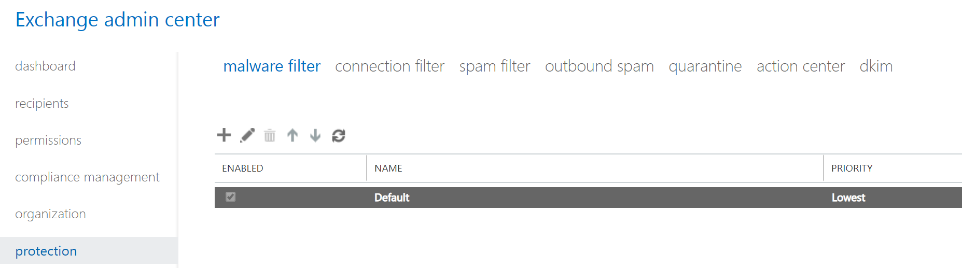
Exchange Admin Center: Protection
This is where you manage anti-malware and anti-spam protection settings
DKIM = DomainKeys Identified Mail

Slide 53
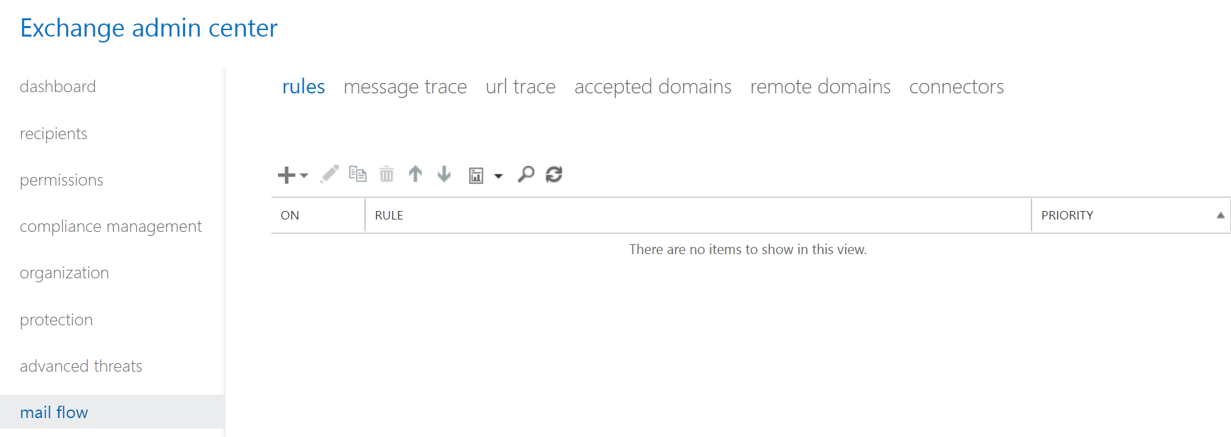
Exchange Admin Center: Mail Flow
Here you manage rules, accepted domains and connectors
This is also where you can perform message trace

Slide 54
SharePoint Online
SharePoint Online is a secure place to store, organize, share and access information
It is a web-based platform by design, but can be consumed in different ways
Highly customizable
Can automate daily tasks
Much more than just a “file server in the cloud”

Slide 55

SharePoint Online hierarchical structure
SharePoint/Office 365 Instance
Site Collection
Site Collection
Site
Site
Site
Site
(Sub)Site
Library
(Sub)Site
Library
Library
Folder
Library
Folder
Folder
Folder

Slide 56
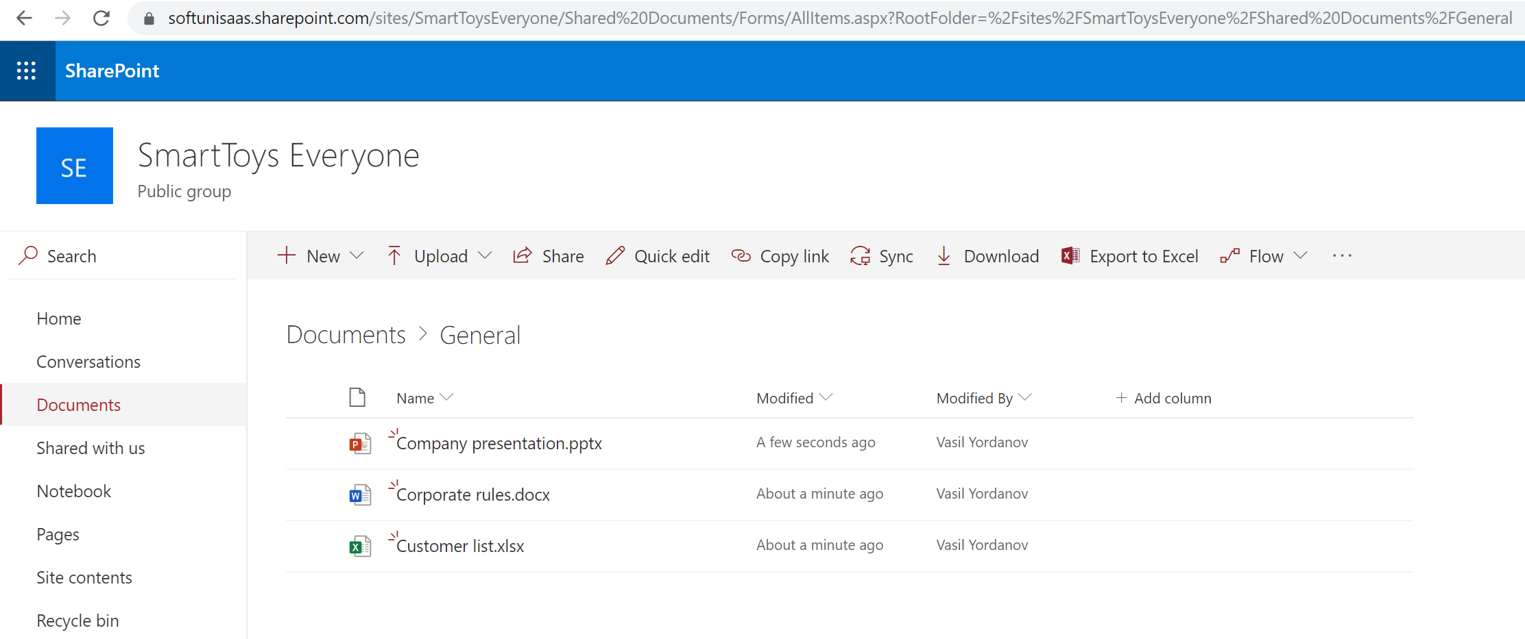
SharePoint Online – example structure
Site Collection (Site)
Library > Folder
Documents

Slide 57
SharePoint Online – external sharing
External sharing allows access from people outside the organization
Two places to define external sharing:
At the organizational level
At the site level
If they don’t match, the more restrictive will apply
Four options/levels of external sharing can be configured (screenshot on the next slide)

Slide 58
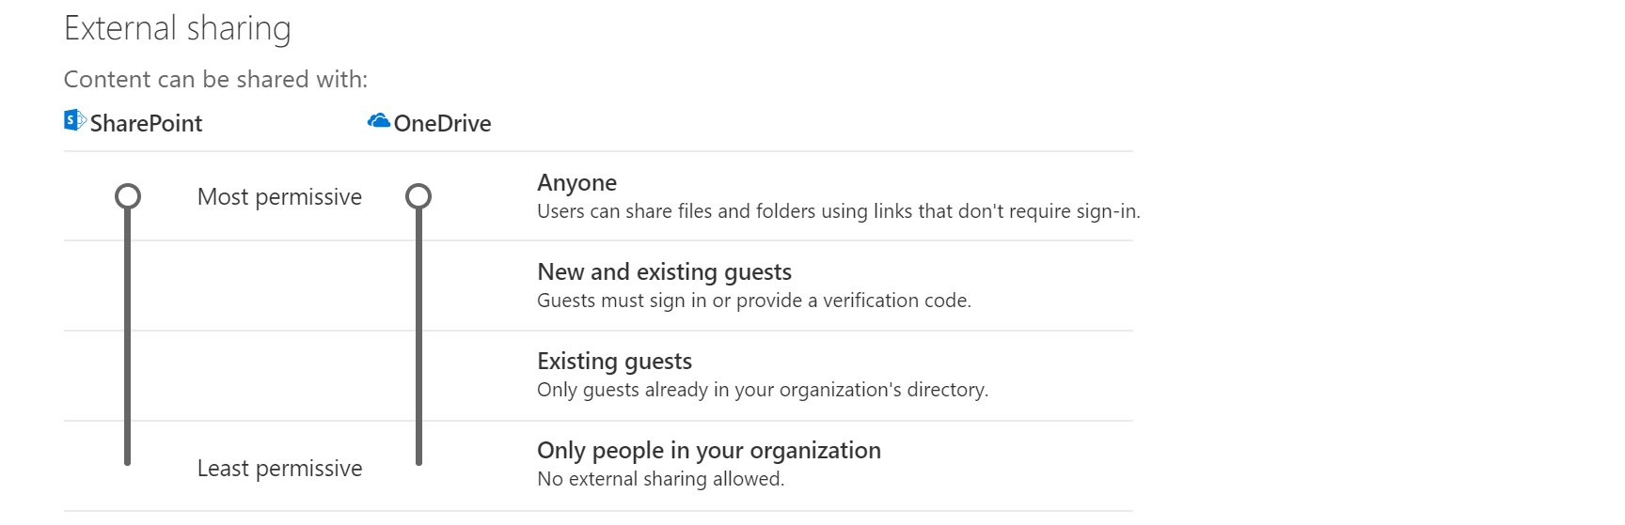
SharePoint Online – external sharing (2)

Slide 59
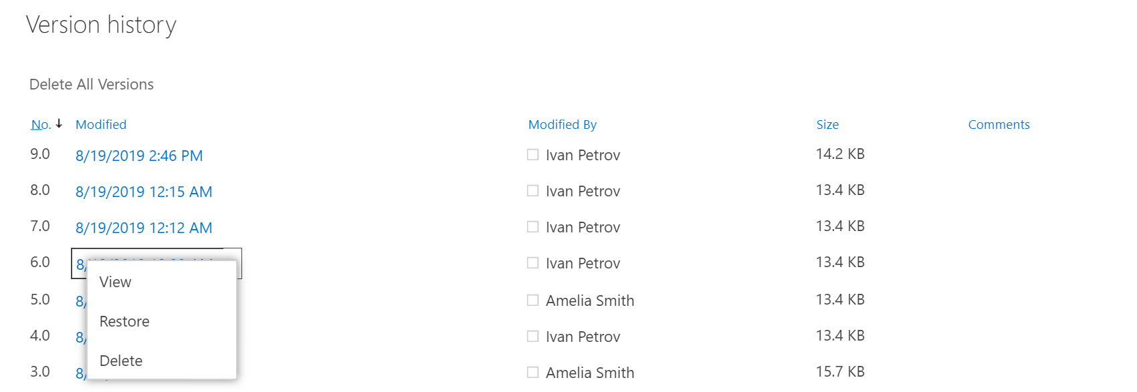
SharePoint Online – versioning
View and recover previous versions from the item's history
Options to use major only or and major and minor versions
Configuration is in the list/library settings

Slide 60
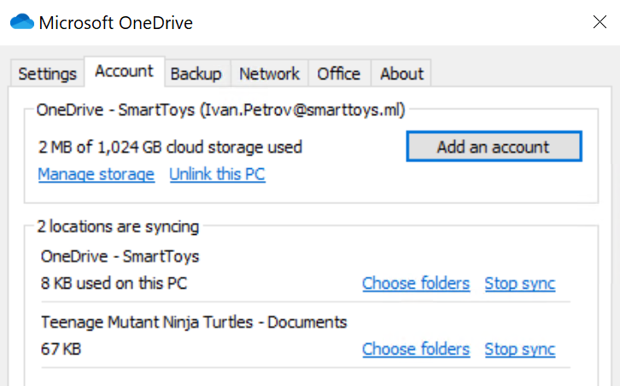
OneDrive for Business
The personal storage for each user, managed by the organization
It is based on SharePoint Online
All files are private unless you decide to share
Each user gets at least 1TB of space in the cloud
The content can be synced locally with the OneDrive sync client*
* The OneDrive sync client can also sync SharePoint libraries

Slide 61
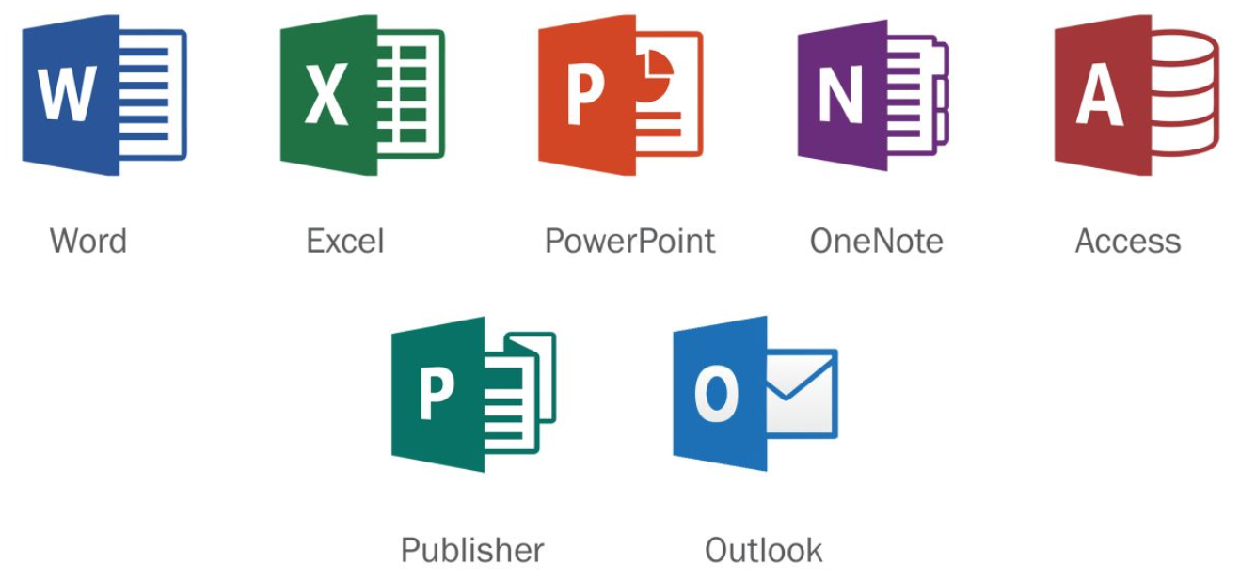
Office 365 ProPlus
Full version of Office, available through Office/Microsoft 365
It is not a web-based version of Office, it is installed on a user’s computer
Includes: Word, Excel, PowerPoint, OneNote, Access, Publisher and Outlook
Uses Click-to-Run installation (vs MSI)
Licensed per user (Can be installed on multiple PCs, tablets and phones)

Slide 62
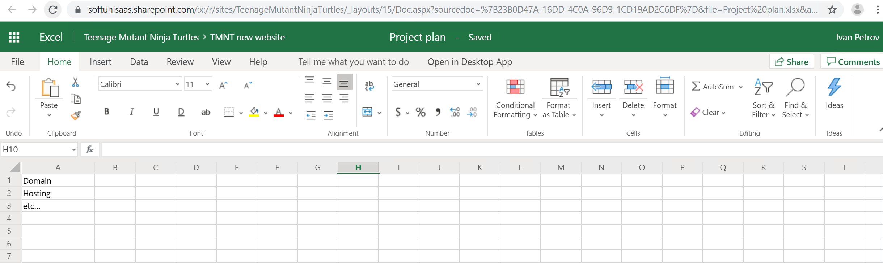
Office for the web
Opens Word, Excel, OneNote, and PowerPoint documents in your web browser
You can view, create, and edit files on the go

Slide 63
Using and administering Microsoft Teams

Slide 64
Different tools for different tasks
Exchange Online
Planner
Yammer
SharePoint Online
Forms
Kaizala
Microsoft Teams
Delve
Flow
more…
OneDrive for Business
Stream
Power BI
Office 365 ProPlus
Sway
PowerApps
Having so many tools can be distractive...

Slide 65
Different tools for different tasks
The single tool
Type of communication
Office 365 tool(s)
Real time:
Skype for Business
Teams
Offline:
Outlook, Yammer, Stream
Teams
Department based:
Groups (security and distribution)
Teams
Project team based:
Groups (security and distribution)
Teams
One-to-one:
Skype for Business, Outlook, OneDrive, Sway, PowerPoint
Teams
One-to-many:
Skype for Business, Outlook, OneDrive, Yammer, Sway, PowerPoint
Teams

Slide 66
What is Microsoft Teams?
Microsoft Teams: the hub for teamwork
The Office/Microsoft 365 all-in-one service for collaboration
Some of the functionalities in Teams:
Audio and video meetings | Bots
Rich chat features | Channels
Access to personal and group files | Customizations
Co-authoring | App integrations and more…

Slide 67
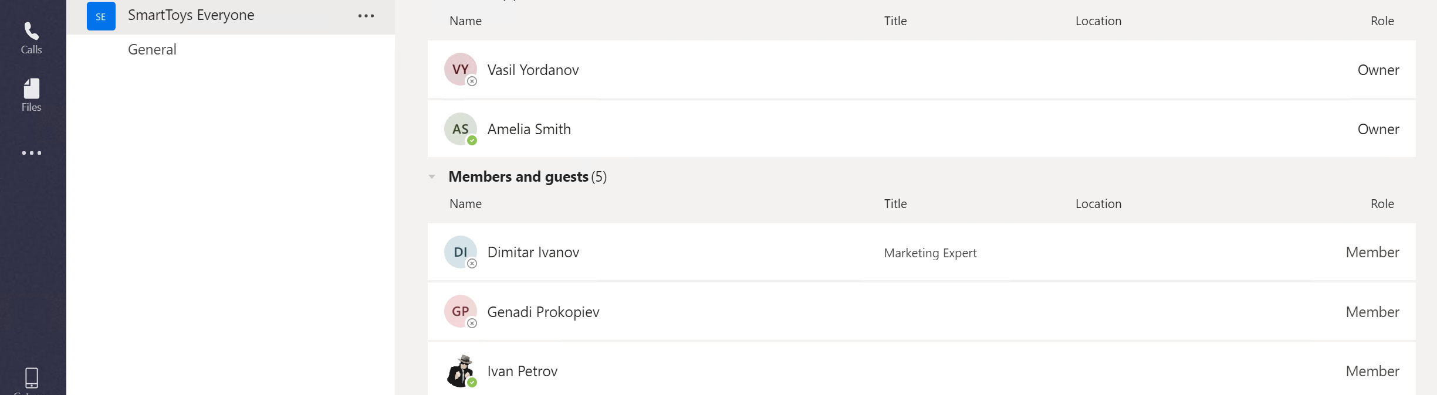
User roles in Teams
Within Microsoft Teams there are two user roles: owner and member
By default, a user who creates a new team is granted the owner status
Details about the difference in permissions can be found here

Slide 68
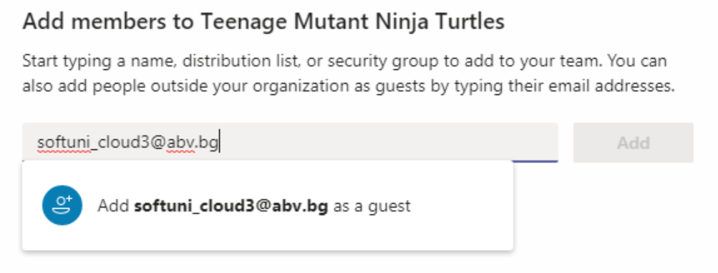
Guest access
Guest access allows people outside your organization to collaborate with your teams
Anyone with a business or a private email can be invited as a guest
The guest functionality must be first enabled inside Teams admin center

Slide 69
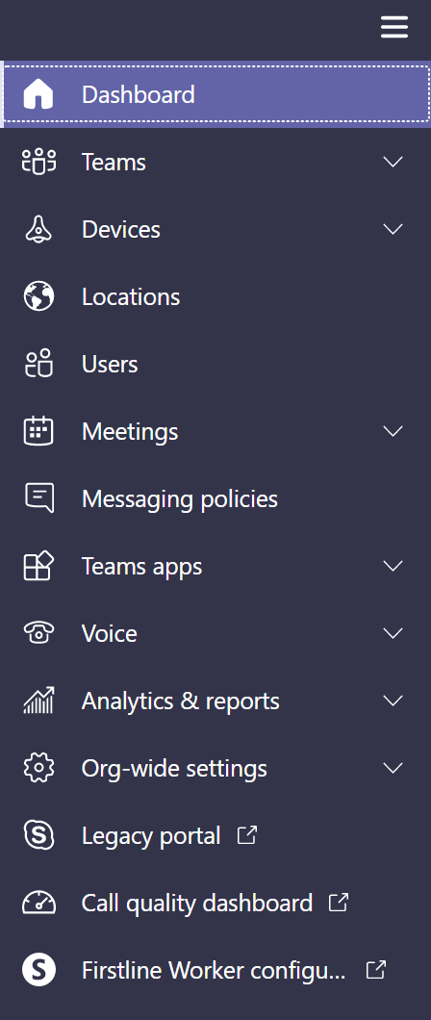
Teams admin center
All global settings and policies can be controlled here
Examples of frequently used configurations:
Guest access
External access
Teams upgrade (coexistence mode)
Meetings and messaging policies

Slide 70
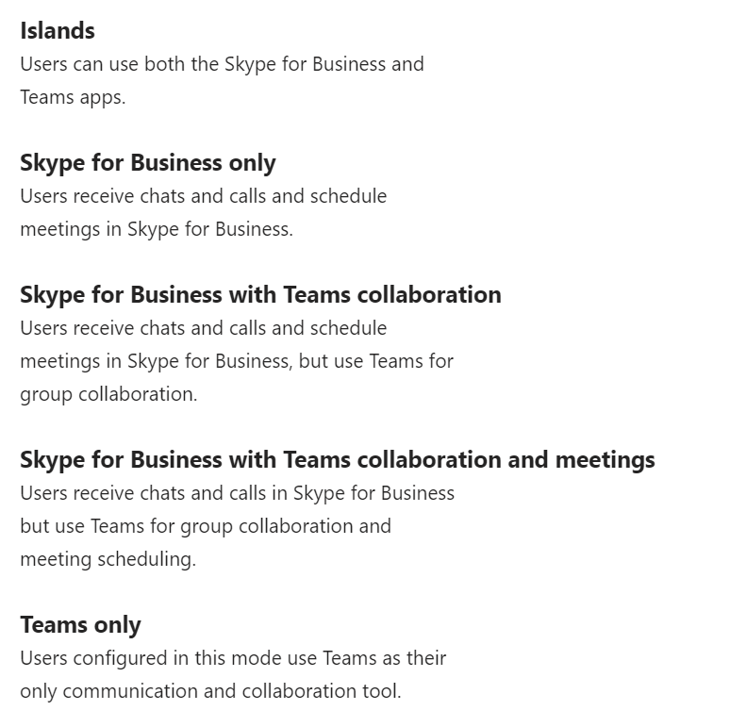
Teams upgrade
Different upgrade (from Skype for Business) options can be configured here
The coexistence mode can be set for the entire organization or on a per user basis
Before deciding when/how to upgrade, implement your user readiness plan

Slide 71



Clients for Microsoft Teams
Desktop client
Windows (7+)
Mac (10.10+)
Web client
Latest versions of IE, Edge, Chrome, Firefox, Safari (some exceptions may apply)
Mobile client
Android (4.4 or later)
iOS (10.0 or later)

Slide 72
Questions
sli.do # SaaS-Security

Slide 73
Security considerations in Exchange Online and SharePoint Online. Mobile Device Management

Slide 74
Security considerations in Exchange Online and SharePoint Online

Slide 75
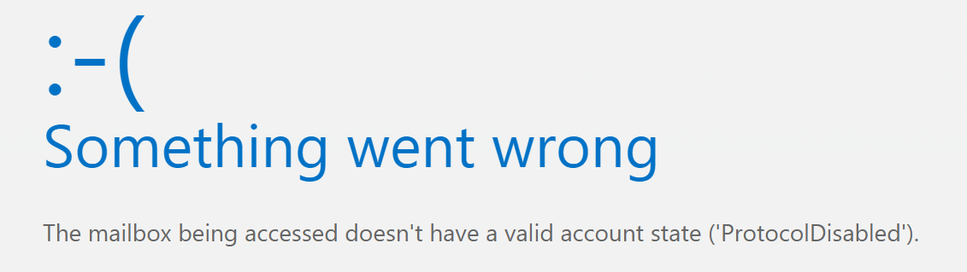
Exchange Online – restricting mailbox access
Mailbox access settings
ActiveSync
OWA for Devices
Outlook on the web
IMAP
POP3
MAPI

Slide 76
Client access rules in Exchange Online
You can control access to your Exchange Online organization based on client properties or client access requests
Some examples:
Allow Exchange ActiveSync clients from specific IP addresses and block all other ActiveSync clients
Block access to Exchange Web Services (EWS) for users in specific departments, cities or countries
Block access to the Exchange admin center (EAC) for users in a specific country or region
Configuration only available in Exchange Online PowerShell (not discussed in this course)

Slide 77
Basic vs modern authentication
Basic authentication:
Is used in older Outlook versions (before 2013)
uses simple HTTP login methods, rather than more complex OAuth-based authentication mechanisms
Enabled by default in Office 365
Modern authentication:
Support for MFA (Multi-factor authentication)
Better protection from brute force and password spray attacks
Enabled by default in Office 365

Slide 78
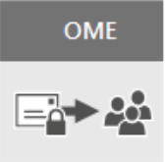
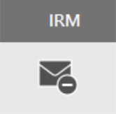
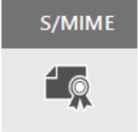
Compare email encryption in Exchange Online
Built on Azure RMS (Rights Management Services)
Use Azure RMS templates to:
Only encrypt
Do not forward
Company protect
No additional setup required
Can configure Exchange Online IRM to use on-premises AD RMS
Not very common
Well known protocol
Used for encryption and signing
Requires certificates and publishing infrastructure
You must have the public keys for each recipient

Slide 79
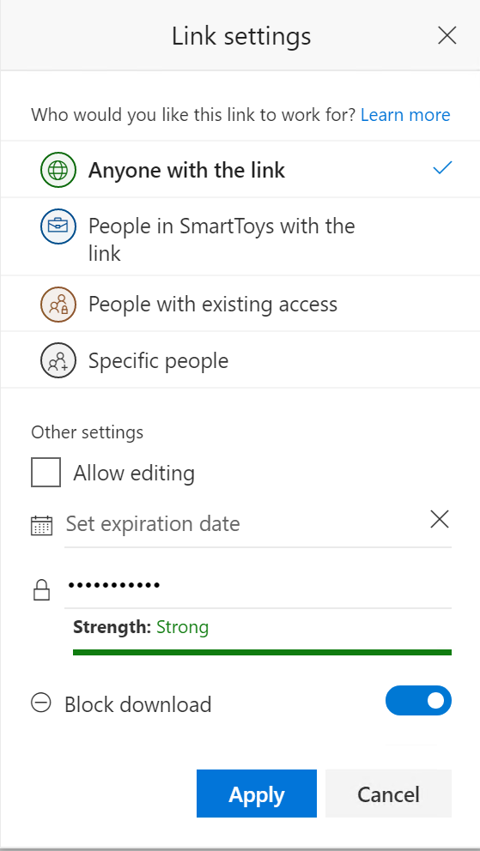
SharePoint Online – anonymous links
Sharing with “anonymous link” may dramatically lower the security since the link can be forwarded to anyone
If possible, minimize the risk by:
Permit read-only access
Set expiration date
Provide password
Block download

Slide 80
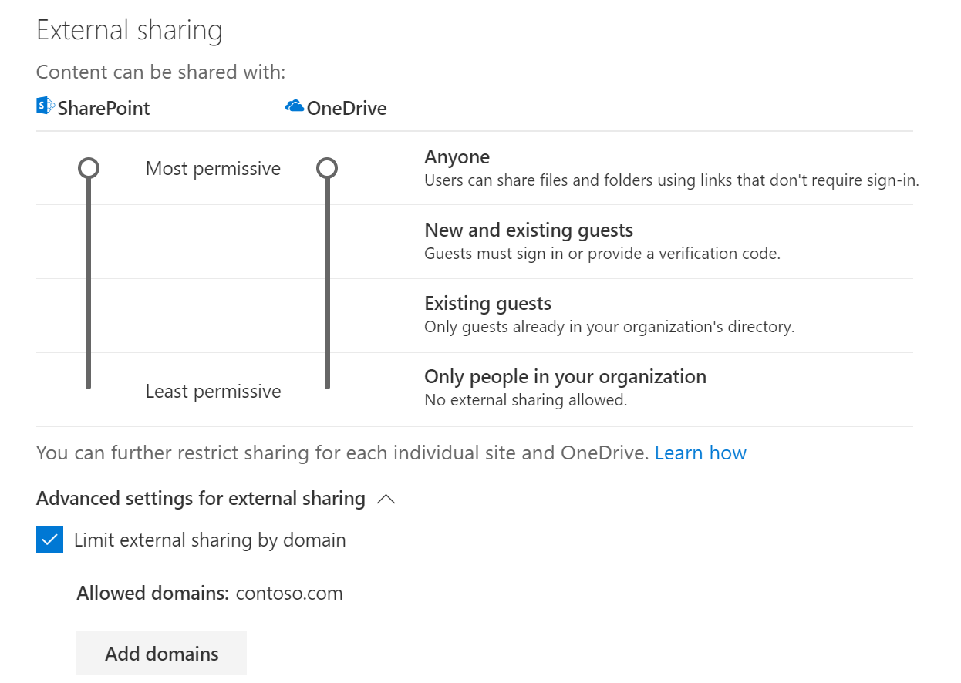
SharePoint Online – limit sharing by domain
Remember, external sharing settings are on two places:
At the organizational level
At the site level
Some additional options to secure external sharing at the organizational level exist
One of them is to limit sharing by domain

Slide 81
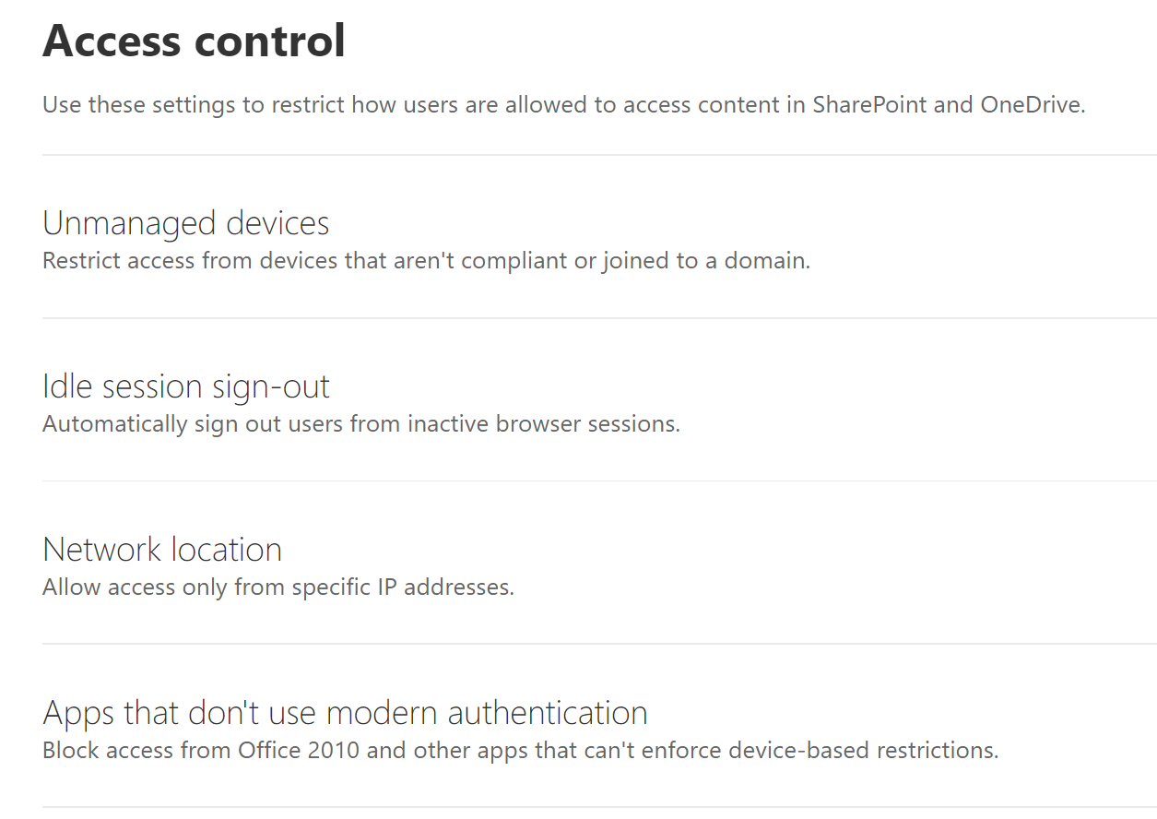
Access control in SharePoint Online
Additional security in SharePoint Online allows you to:
Control the behavior of uncompliant or not domain joined devices
Auto sign-out inactive users
Control access based on network (IP) location
Allow or block access from apps which do not support modern authentication

Slide 82
Office 365 Advanced Threat Protection (ATP)

Slide 83
What is Office 365 ATP
Office 365 ATP capabilities:
Safe attachments
Safe links
Anti-phishing policies
ATP for SharePoint, OneDrive and Teams
Office 365 attack simulator
More…

Slide 84
What is Office 365 ATP (2)
Office 365 ATP is part of Microsoft Threat Protection
ATP Plan 1 vs ATP Plan 2
ATP is included in Office 365 Enterprise E5, Office 365 Education A5, and Microsoft 365 Business

Slide 85
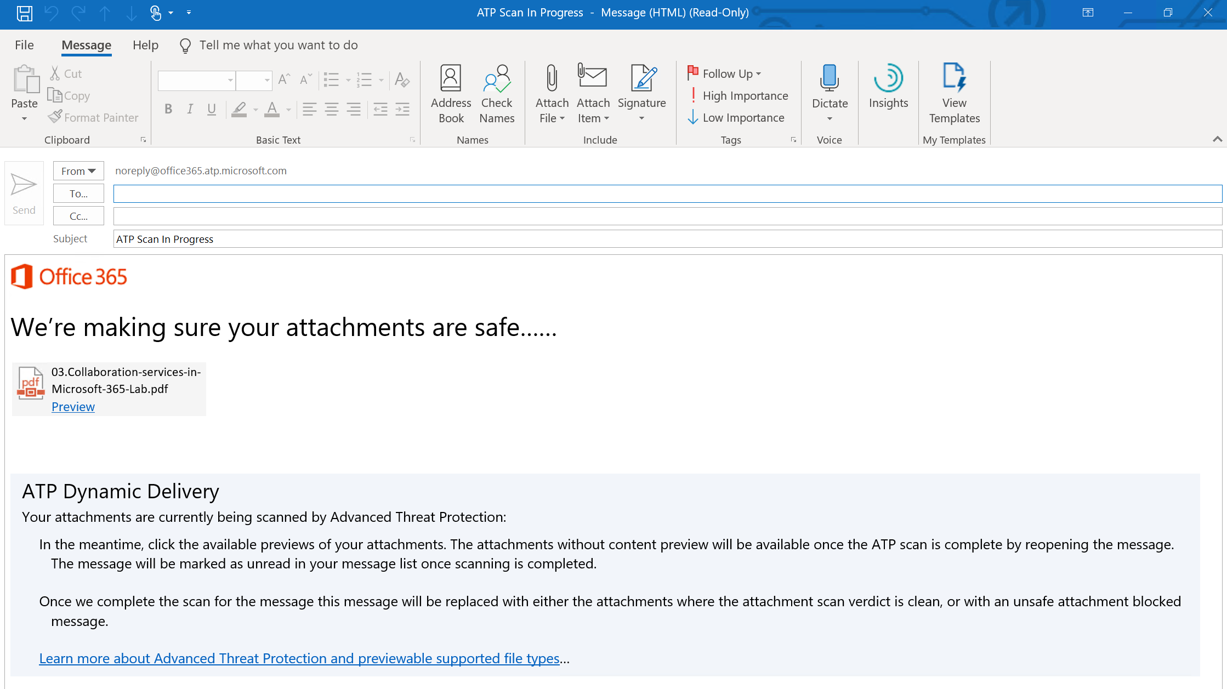
Safe attachments

Slide 86
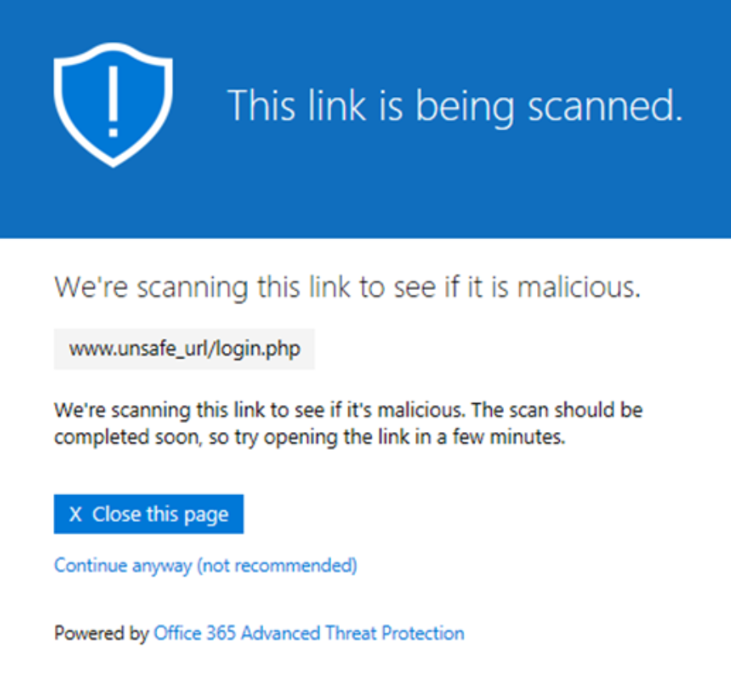
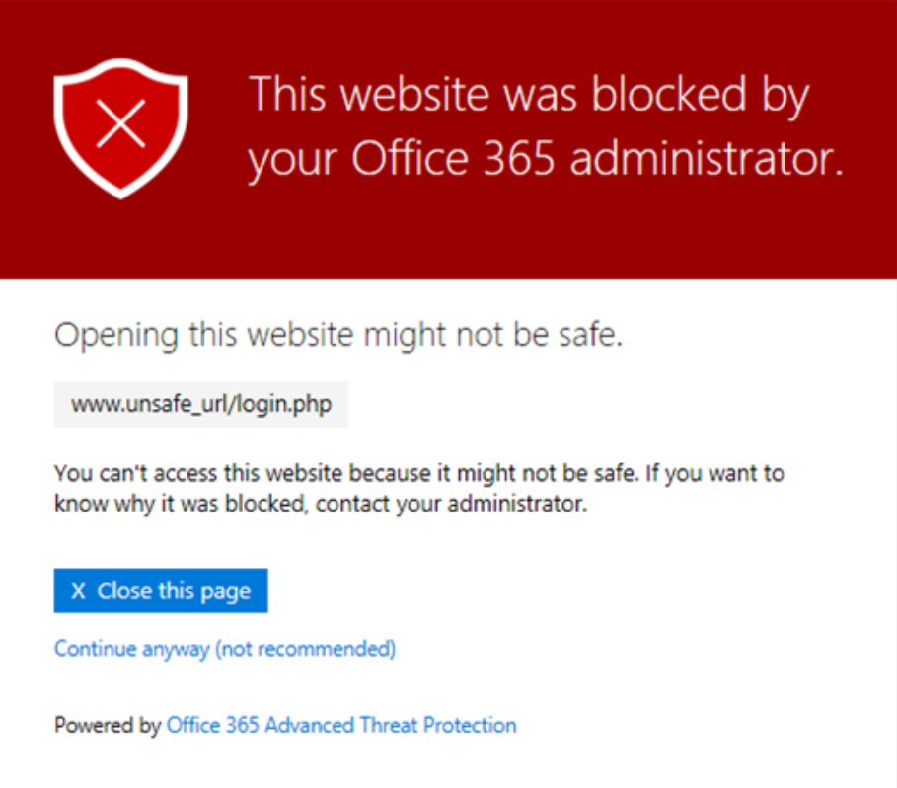
Safe links

Slide 87
Using Microsoft Intune as MDM

Slide 88

Security vs usability
Usability
Security

Slide 89


Full lifecycle management
Enroll
Provide a self-service Company Portal for users to enroll devices
Deliver custom terms and conditions at enrollment
Bulk enroll devices using Apple Configurator or service account
Restrict access to Exchange email if a device is not enrolled
Provision
Deploy certificates, email, VPN, and WiFi profiles
Deploy device security policy settings
Install mandatory apps
Deploy app restriction policies
Deploy data protection policies
User
IT
Retire
Revoke access to corporate resources
Perform selective wipe
Audit lost and stolen devices
Manage and Protect
Restrict access to corporate resources if policies are violated (e.g., jailbroken device)
Protect corporate data by restricting actions such as copy, cut, paste, and save as between Intune-managed apps and personal apps
Report on device and app compliance

Slide 90
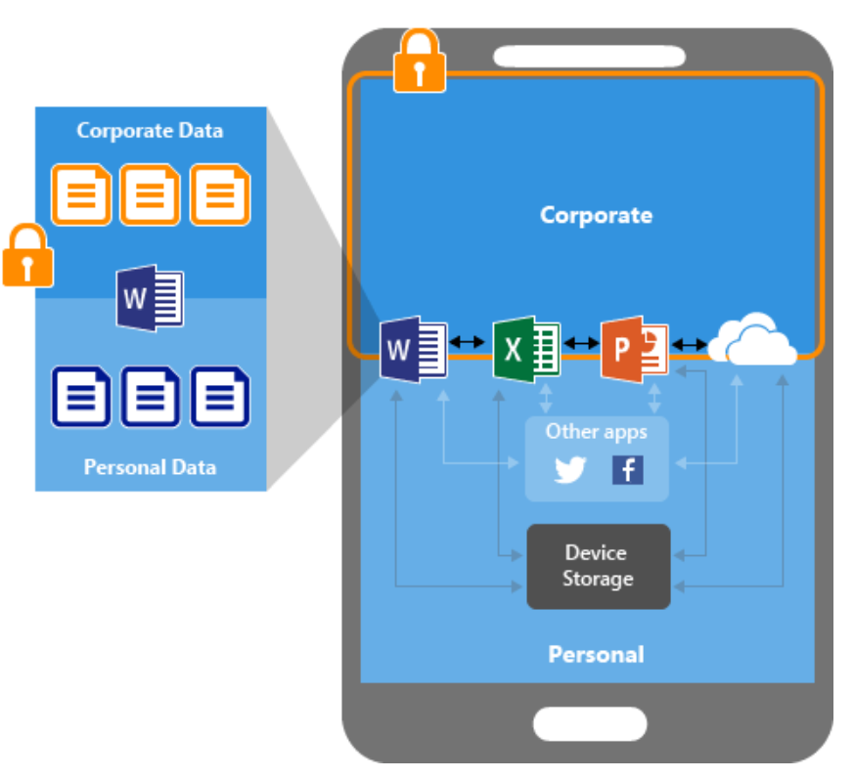
Mobile Application Management (MAM)
Known as “App protection policies”
Protecting your company data at the app level
End-user productivity isn't affected – policies do not apply for the same app if the data is personal
App-layer protection examples:
Require PIN to open an app
Control sharing of data between apps
Prevent saving to personal storage/location

Slide 91
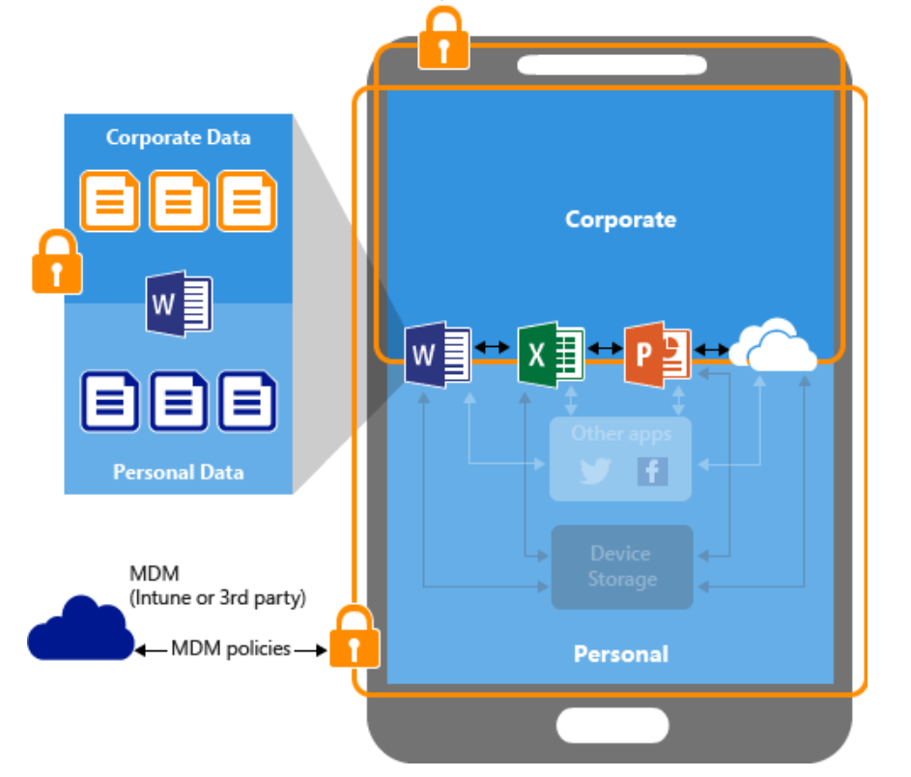
Mobile Device Management (MDM)
Additional level of security – the whole device is now protected
Device-layer protection examples:
Require PIN to access the device
Deploy apps to the device
Restrict camera usage
Remote wipe
The device must be enrolled in Intune
In this picture, we have MDM + MAM protection

Slide 92
Which client app?
In BYOD (bring your own device) scenarios, the enrollment process is initiated by the user
When trying to access the corporate email, users may want to use other (than Outlook) client apps:
Android: Gmail (or something else)
iOS: Mail (or something else)
How do we protect the app (and the device) in this situation?

Slide 93
Conditional access
With conditional access policies we can enforce the user to use an “approved” client app
The logic is:
IF you want to use the corporate email, THEN you must use Microsoft Outlook
Microsoft Outlook is an approved app, which is subject to app protection policies
This is how we enforce MAM

Slide 94
Conditional access (2)
With conditional access policies we can enforce the user to use an “approved” client app and the device to be enrolled in Microsoft Intune
The logic is:
IF you want to use the corporate email, THEN you must use Microsoft Outlook and make your device managed
Microsoft Outlook is an approved app, which is subject to app protection policies
This is how we enforce MAM and MDM

Slide 95
Questions
sli.do # SaaS-Security

Slide 96
Microsoft 365 Information Protection

Slide 97
Information protection technologies

Slide 98
Encryption at rest vs encryption in transit
Kinds of content | Encryption technologies
Files on a device. This can include email messages saved in a folder, Office documents saved on a computer, tablet, or phone, or data saved to the Microsoft cloud | BitLocker in Microsoft datacenters. BitLocker can also be used on client machines, such as Windows computers and tablets Distributed Key Manager (DKM) in Microsoft datacenters Customer Key for Microsoft 365
Files in transit between users. This can include Office documents or SharePoint list items shared between users | TLS for files in transit
Email in transit between recipients. This includes email hosted by Exchange Online | Office 365 Message Encryption with Azure Rights Management, S/MIME, and TLS for email in transit

Slide 99
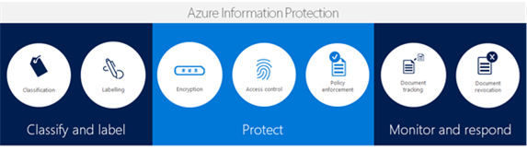
Azure Information Protection
Classify your data based on sensitivity
No matter where it is stored - protection follows the document
Deployment flexibility and ease of use

Slide 100
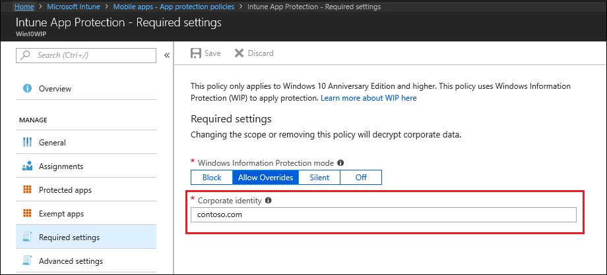
Windows Information Protection (WIP)
Windows Information Protection helps protect your corporate data by separating the business and the personal data and applying restriction policies
WIP is the mobile application management (MAM) mechanism on Windows 10
The WIP feature is built in Windows 10 (version 1607 and later)

Slide 101
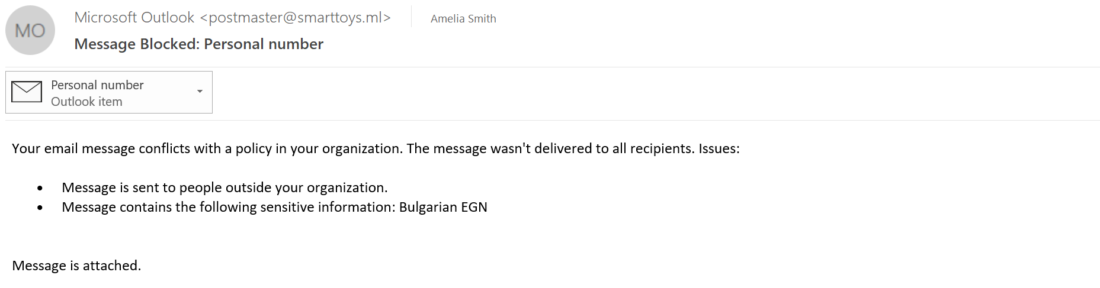
Data Loss Prevention
Data Loss Prevention (DLP) is a security feature that protects sensitive data in email, SharePoint content, and Office files from being accidentally or intentionally shared with unauthorized users

Slide 102
Cloud app security
Cloud App Security provides a dashboard to discover, investigate and control what cloud applications are being used in your organization
Discovers and controls the use of Shadow IT
Detects and fights against cyberthreats across all your Microsoft and third-party cloud services

Slide 103
Azure Information Protection

Slide 104

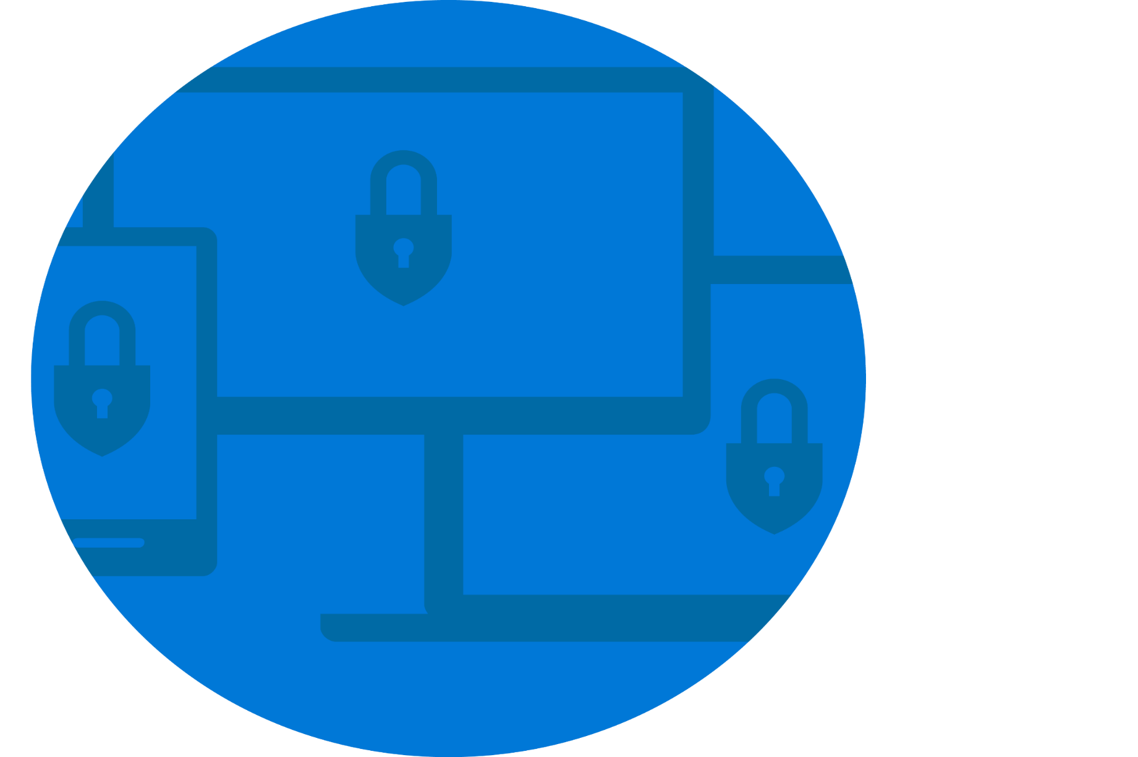

Where is your protection?
Hybrid data = new normal
It is harder to protect
Unregulated, unknown
Identity, device management protection
Managed mobile environment
Perimeter protection
On-premises

Slide 105

Azure Information Protection
Full Data Lifecycle
CLASSIFICATION
LABELING
ENCRYPTION
ACCESS CONTROL
POLICY ENFORCEMENT
DOCUMENT TRACKING
DOCUMENT REVOCATION
Classify & Label
Protect
Monitor & Respond

Slide 106

AIP labels
Contains settings on how to mark and optionally protect documents
Sub-labels add additional settings to a label
Before creating labels, you must have your classification strategy
AIP provides default labels and policies when enabled in your tenant

Slide 107

Classification and labeling
Automatic classification
Policies can be set by IT Admins for automatically applying classification and protection to data
Recommended classification
Based on the content you’re working on, you can be prompted with suggested classification
Manual reclassification
You can override a classification and optionally be required to provide a justification
User-specified classification
Users can choose to apply a sensitivity label to the email or file they are working on with a single click
HIGHLY CONFIDENTIAL
CONFIDENTIAL
PERSONAL
GENERAL
PUBLIC

Slide 108

Working with AIP labels
You can see your configured labels and sub-labels when opening suported Office application on a client that has the Azure Information Protection client installed
You can use Azure Portal to create additional labels (and sub-labels) with special settings for your users

Slide 109
AIP policies
A policy is an additional set of rules that are used to group labels to be available for users or groups
All predefined labels and sub-labels in Office 365 are configured in the default policy named “Global”
You cannot scope Global policy to any specific users or groups
The following rules apply when creating new policies:
Custom labels can be added to only one policy
To add a sub-label, its parent label must be in the same policy or in the global policy
The Azure Information Protection client checks for any changes whenever a supported Office application starts

Slide 110
AIP clients
AIP provides a client-server solution that helps to protect an organization's documents and emails
Two options for AIP client download:
AIP classic client (more features, currently)
AIP unified labeling client (can also be used by MacOS, iOS, and Android)
Full comparison between the clients can be found here
Options to install the AIP client:
Manually run the executable (.exe) version
Centrally deploy the windows installer (.msi) version
Notes:
https://docs.microsoft.com/en-us/azure/information-protection/rms-client/use-client#choose-which-azure-information-protection-client-to-use

Slide 111
Automated labeling
The automatic labeling feature can assign labels to documents, files and emails without user interaction when configured conditions are met
Automatic labeling consists of:
Conditions for applying labels automatically
Automatic processing and recommendations for emails with attachments
The on-premises Azure Information Protection scanner to label local documents and files
The automatic labeling requires an AIP Premium P2 license

Slide 112
Configuring a super user
AIP “super user” ensures that authorized people and services can always read and inspect the data that Azure Rights Management protects for your organization
The Super User feature is a feature to access all protected content of your tenant
By default, the super user feature is not enabled
The Super User is configured with the PowerShell cmdlets from the AADRM module (AIPService is the new name)

Slide 113

Implement bulk classification
This scanner runs as a service on Windows Server and lets you discover, classify, and protect files on the following data stores:
Local folders on the Windows Server computer that runs the scanner
UNC paths for network shares that use the Server Message Block (SMB) protocol
Document libraries and folders for SharePoint Server 2019 through SharePoint Server 2013

Slide 114
Data Loss Prevention

Slide 115
What is Data Loss Prevention
Data loss prevention (DLP) is a security feature that protects sensitive data in email, SharePoint content, and Office files from being accidentally or intentionally shared with unauthorized users
With a DLP policy, you can:
Identify sensitive information across Exchange Online, SharePoint Online, OneDrive for Business, and Microsoft Teams
Prevent the accidental sharing of sensitive information
Help users learn how to stay compliant without interrupting their workflow
View DLP reports showing content that matches your organization's DLP policies

Slide 116
Sensitive information types
DLP includes many sensitive information types ready to be used in DLP policies
Defined by a pattern that can be identified by a regular expression or a function
Additional evidence (such as keywords) can be used to identify a sensitive information type
Confidence level and proximity are also used in the evaluation process
Can create your own, custom sensitive information types

Slide 117

DLP policy
With a DLP policy, you can:
Identify sensitive information across Exchange Online, SharePoint Online, OneDrive for Business, and Microsoft Teams
Prevent the accidental sharing of sensitive information
Help users learn how to stay compliant without interrupting their workflow
View DLP reports showing content that matches your organization’s DLP policies

Slide 118

Summary
Cloud services concepts. Introducing Microsoft 365
Identity management
Collaboration services in Microsoft 365
Security considerations in Exchange and SharePoint Online. Mobile Device Management
Microsoft 365 Information Protection
…
…
…

Slide 120






СофтУни диамантени партньори

Slide 121






СофтУни диамантени партньори

Slide 122





Trainings @ Software University (SoftUni)
Software University – High-Quality Education, Profession and Job for Software Developers
softuni.bg
Software University Foundation
http://softuni.foundation/
Software University @ Facebook
facebook.com/SoftwareUniversity
Software University Forums
forum.softuni.bg

